Slide 1



BRIGHTTv Viewership Analysis
Busile Ndhlovu

Slide 2


Contents
01
02
03
Objective
Overview of the Data
Insights on user and user trends
04
05
06
Factors influencing consumption
Recommendations to increase consumption
Initiative to grow BrightTv’s user base
2

Slide 3

01
Objective
3

Slide 4

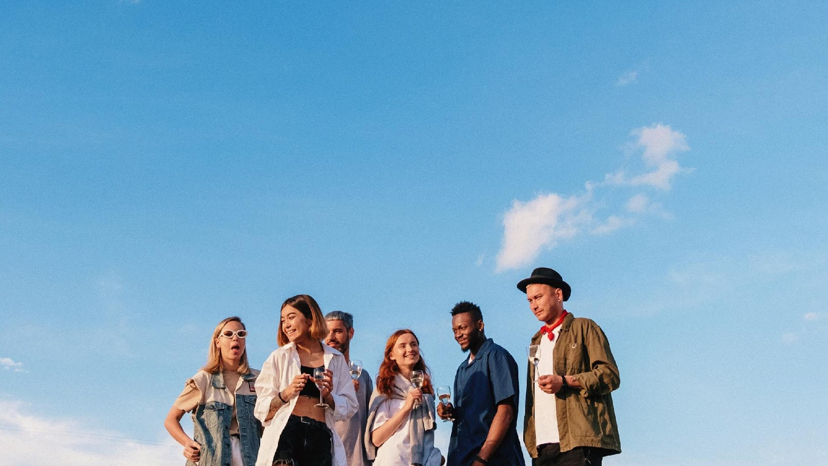


Objective
Increase BrightTv’s subscription base within this financial year, by providing actionable insights to assist the CVM team.
4

Slide 5

02
Data Overview
5

Slide 6

Data Overview
The dataset provided consisted of two tables User Profile and Viewership, these tables provided information about the users and their activity on the site.
The dataset was from the months January, February and March from the year 2016.
6

Slide 7
03
Insights on user and user trend
7

Slide 8
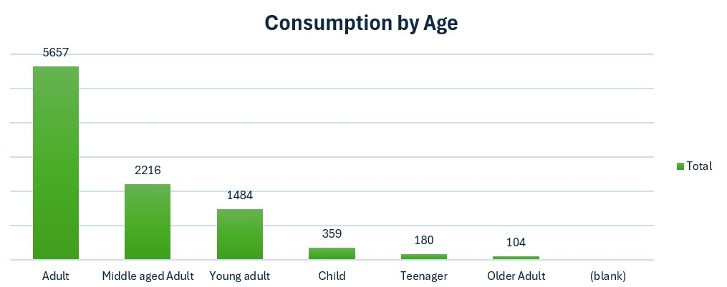
User demographics
The age group with the highest viewership is Adult which ranges from 25- 39 year olds, which makes up 56% of the total views.
8

Slide 9
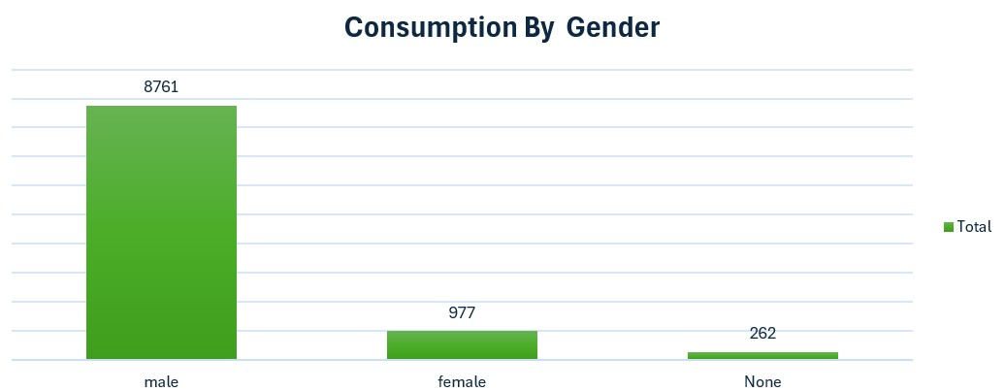
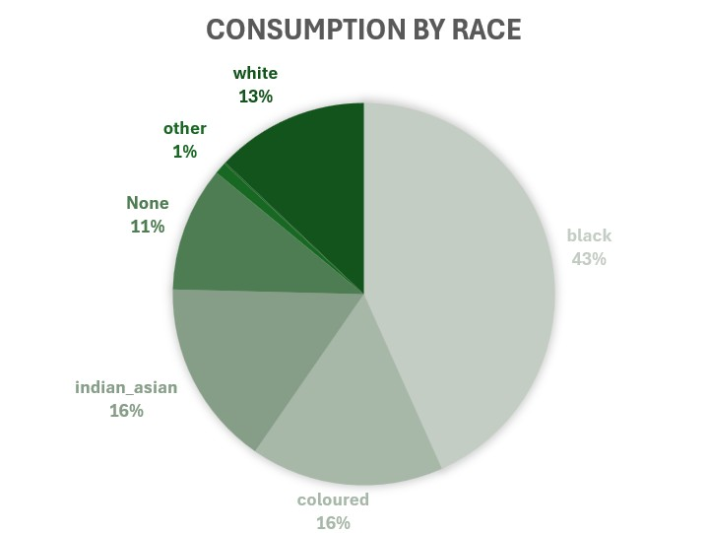
User demographics
The men have the highest viewership which makes up 88% of the total viewership
Black people make up 43% of the total Viewership which makes up almost triple the second highest consumption by race
9

Slide 10
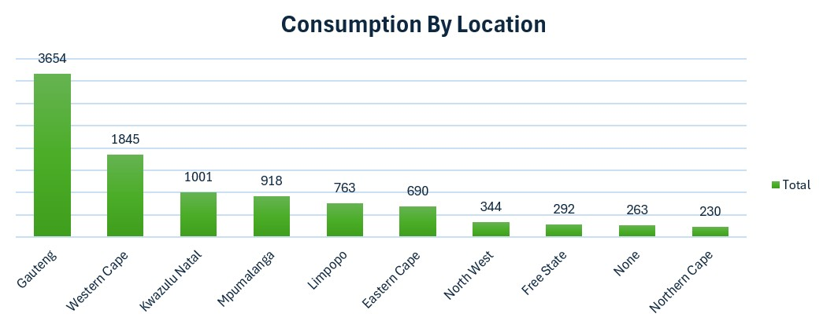
User demographics
Gauteng takes the lead with 3654 views which makes up 37 % of the total views.
From these users demographics I can conclude that BrightTvs main consumers are black men that range from the ages of 18-39 who reside in Gauteng.
10

Slide 11
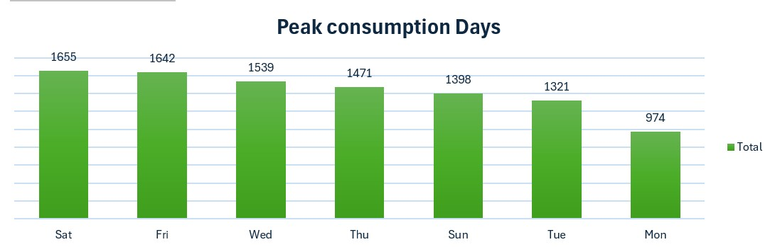
Usage patterns
Saturday and Friday are our highest consumption days Saturday leading with 17 % and Friday with 16 % of the total views. This could be because of availability since Friday is the beginning of a weekend.
11

Slide 12
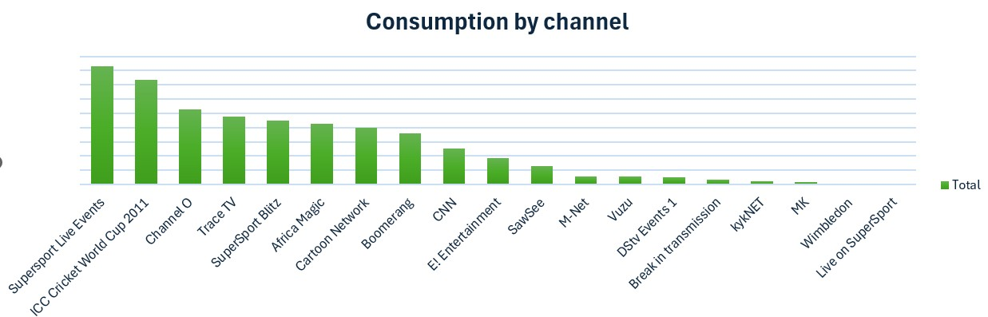

Usage patterns
Top 5 Channels | Views | Percentage
1.SuperSport Live Events | 1662 | 17%
2.ICC Cricket world Cup 2011 | 1465 | 15%
3. Channel O | 1050 | 11%
4. Trace TV | 952 | 10%
5.SuperSport Blits | 896 | 9%
The top 5 Moat watched channels fall under sports and music channels
12

Slide 13
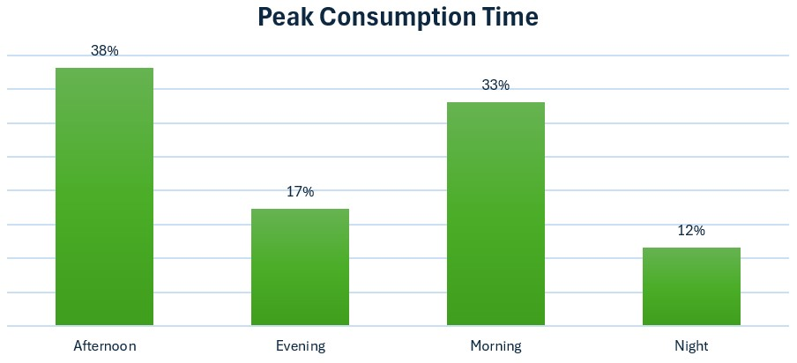
Usage patterns
Time Interval | Category
00:00 – 06:59 | Night
07:00 – 12:59 | Morning
13:00 – 18:59 | Afternoon
19:00 – 23:59 | Evening
From these users patterns I can conclude that BrightTvs main consumers days are Saturday and Friday with our top 5 channels falling under music and sports channels.
13

Slide 14

04
FACTORS INFLUENCING CONSUMPTION
14

Slide 15

Factors Influencing Consumption
Sports events draw massive viewership, particularly live events.
Music channels attract consistent engagement.
Prime time evenings, weekends(Friday and Saturday) and public holidays are high-consumption periods.
Group activities such as family viewings or sports gatherings likely amplify engagement.
15

Slide 16
05
RECOMMENDATIONS TO INCREASE CONSUMPTION
16

Slide 17

Recommendations to increase consumption
Run promotional campaigns targeting Gauteng residents using ads highlighting popular content like sports and music.
Partner with local influencers, particularly those in sports and entertainment industries
Offer “refer-a-friend” discounts or free trial subscription(1 month free)
Partner with sports leagues(e.g. cricket or football) to offer live-streaming of events exclusively.
Collaborate with artists featured on music channels (e.g. Channel O, Trace TV) for exclusive content.
Organize viewing events for big sports matches or concerts in local venues collaborate with TikTok influencers.
Expand BrightTvs reach by leveraging partnership with mobile carries or bundling services with internet providers.
17

Slide 18


06
INITIATIVE TO GROW BRIGHTTVS USER BASE
18

Slide 19
Initiative to Grow BrightTvs User Base
Introduce weekday- specific programming ( Monday Sports Recap or Midweek movie night)
For Sunday: Cultural or inspirational programming(e.g. African Story telling, religious content)
Allow viewers to vote for favourite shows or curate playlist, particularly on low-consumption days.
Replay iconic matches or moments from SuperSport Live Event to engage sports fans even during off-peak days.
19

Slide 20
THANKS!
Do you have any questions?
busindhlovu21@gmail.com
+27 646 400 848
20

